Slide 1
PLANT DISEASE DETECTION
Group No 14
Shyam Kawale [29]
Bhargav Pawar [50]
Nishant Bhat [43]
Abhijit Gawai [18]
Guide – Prof Premanand Gadekar Sir

Slide 2
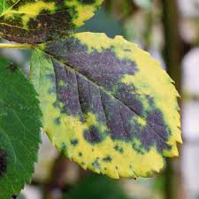
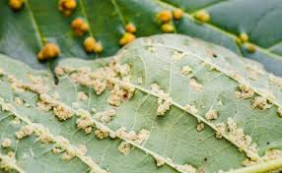
INTRODUCTION
Diseases in plants cause major production and economic losses in agriculture industries worldwide.
Early information on crop health and disease detection can facilitate the control of diseases.

Slide 3
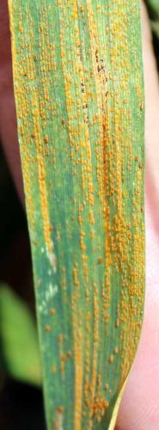
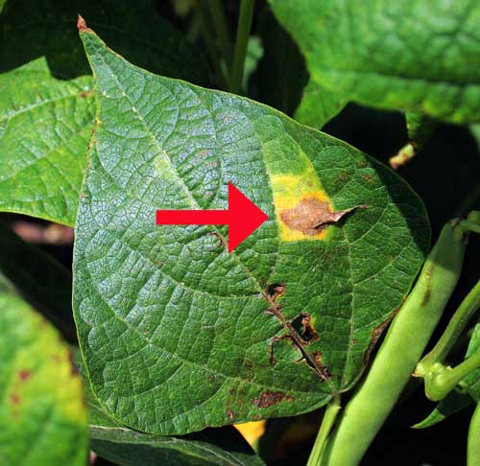
TYPES OF DISEASES
Fungal disease signs:
Leaf rust (common leaf rust in corn)
Stem rust (wheat stem rust)
Sclerotinia (white mold)
Powdery mildew
Fungal disease symptoms:
Birds-eye spot on berries (anthracnose)
Damping off of seedlings (phytophthora)
Leaf spot (septoria brown spot)
Chlorosis (yellowing of leaves)
Bacterial disease signs (difficult to observe, but can include):
Bacterial ooze
Water-soaked lesions
Bacterial streaming in water from a cut stem
Bacterial disease symptoms:
Leaf spot with yellow halo
Fruit spot
Canker
Crown gall
Sheperd’s crook stem ends on woody plants

Slide 4
Database
Taken From Kaggle.com
Contains 1000- 3000 pics of almost every diseases.
Around 100 plants.
Plants like pepper, tomato, potato etc.
Every Plant has 2 main class
1) Healthy
2) Diseases
https://www.kaggle.com/emmarex/plant-disease-detection-using-keras

Slide 5
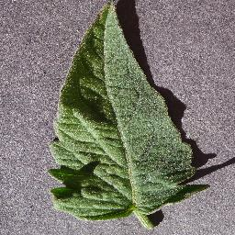
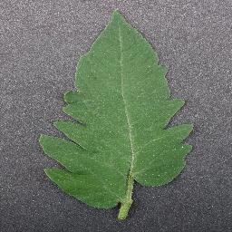
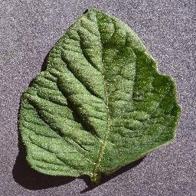
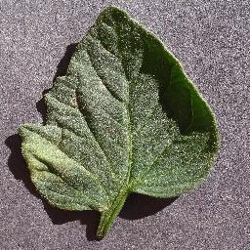
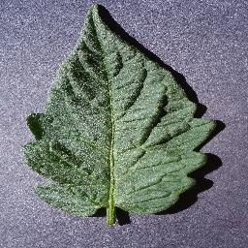
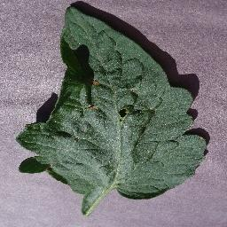
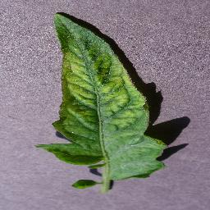
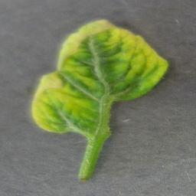
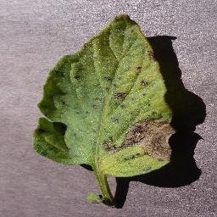
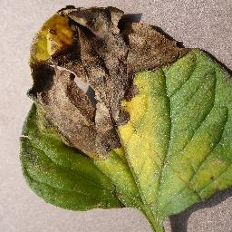
Tomato Plant
Healthy Plant Leaves:
Diseases Class Type:
A. Target Spots
B. Mosaic Virus
C. Yellow Leaf Curl Virus
D. Early Blight
E. Late Blight
…

Slide 6
LITERATURE REVIEW
Vijai Singh et al. has detected plant leaf using image segmentation and soft computing techniques. They have used genetic algorithm for this purpose. Genetic algorithm belong to evolutionary algorithms which generate solutions for optimization problems.(2017)
Muhammad Hammad Saleem et al. has done plant disease detection and classification by deep learning. They have actually proposed different deep learning models that can be used for disease detection like lenet,alexnet etc. They have explained various dl approaches for the detection of plant diseases. Moreover, they have summarized many visualization techniques/mappings to recognize the symptoms of diseases.(2019)
Paper presents classification and detection techniques that can be used for plant leaf disease classification. Here preprocess is done before feature extraction. RGB images are converted into white and then converted into grey level image to extract the image of vein from each leaf. Then basic Morphological functions are applied on the image. Then the image is converted into binary image. After that if binary pixel value is 0 its converted to corresponding RGB image value. Finally by using pearson correlation and Dominating feature set and Naïve Bayesian classifier disease is detected.

Slide 7
Libraries Used
numpy
cv2
os
pickle
sklearn
keras
matplotlib

Slide 8
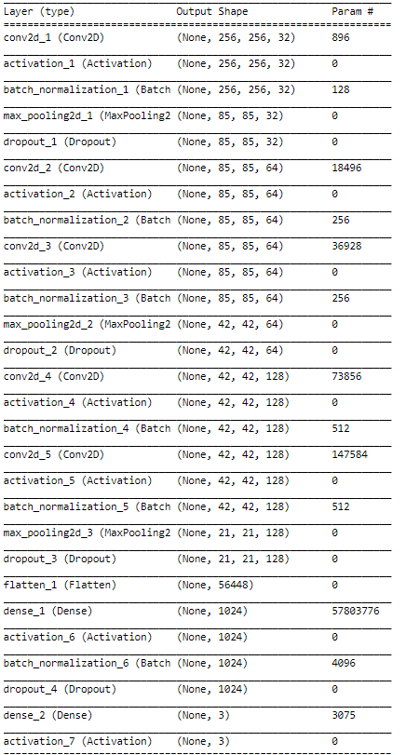

Neural Network Architecture
Dataset consists of 256 x 256 pixel images

Slide 9
THANK YOU

